Slide 1
Cucumber (Behaviour Driven Development)
Session2 Anshul Sonpure

Slide 2
Topic of discussion
What are Cucumber Features?
Anatomy of a Feature File
Writing Feature Files
Cucumber Tags
Cucumber Step Definitions
What are Step Definitions?
Anatomy of a Step Definition
Writing Step Definitions
Parameterizing Step Definitions
Cucumber Options
Different cucumber options

Slide 3
What are Cucumber Features?
In Cucumber, a feature is a high-level description of the functionality to be tested. It describes the behavior of a system from the user’s perspective in a plain, readable language that can be understood by stakeholders, developers, and testers alike.
Features are written in the form of feature files, which are plain text files with the extension .feature. Each feature file contains a single feature, which is made up of one or more

Slide 4
Writing Cucumber Features
To write a Cucumber feature, you need to follow these steps:
Identify the feature you want to test.
Write a feature description in a feature file using the Gherkin syntax.
Identify the scenarios that you want to test for the feature.
Write a scenario description in the feature file using the Gherkin syntax.
Write steps for the scenario, which will define the behavior of the system for the given scenario.
Create step definition methods in the corresponding step definition file that will execute the steps defined in the feature file.
Run the test to verify that the feature and scenarios are working as expected.

Slide 5
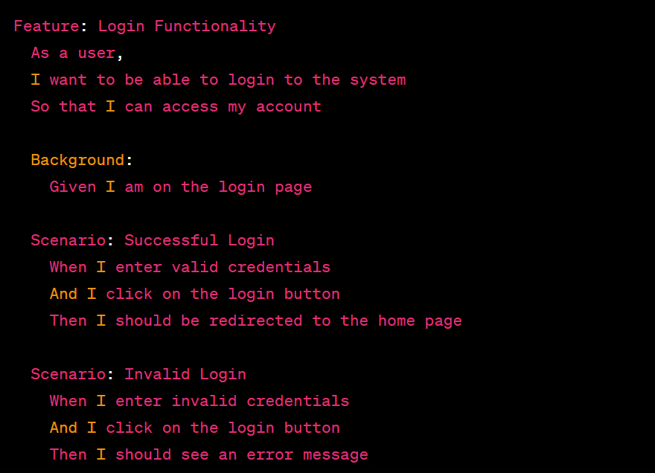
Writing Cucumber Features
In this example, the feature file describes a login functionality that has two scenarios – one for successful login and another for invalid login. The feature file also includes a background section that defines a common step for all scenarios in the feature.

Slide 6
Anatomy of a Feature File
A feature file consists of a number of different sections that describe different aspects of the feature. Here is a brief overview of each section:
Feature – The name of the feature being tested. This should be a concise, human-readable summary of the functionality that the feature is testing.
Description – A short description of the feature that provides additional context and helps to clarify what the feature is intended to do.
Background – The background section is used to define steps that are common to all scenarios in the feature. This helps to keep the scenarios concise and focused on the specific functionality being tested.
Scenario – A scenario is a single test case that describes a particular behavior of the system. A feature can have one or more scenarios, each with its own unique name and set of steps.
Scenario Outline – A scenario outline is used when a scenario has multiple variations that are similar but have different inputs or expected outputs. It allows you to define a single scenario that can be reused for multiple variations.
Examples – The examples section is used to provide data for a scenario outline. It defines a set of input and output values that are used to run the scenario with different inputs and verify the expected outputs.

Slide 7
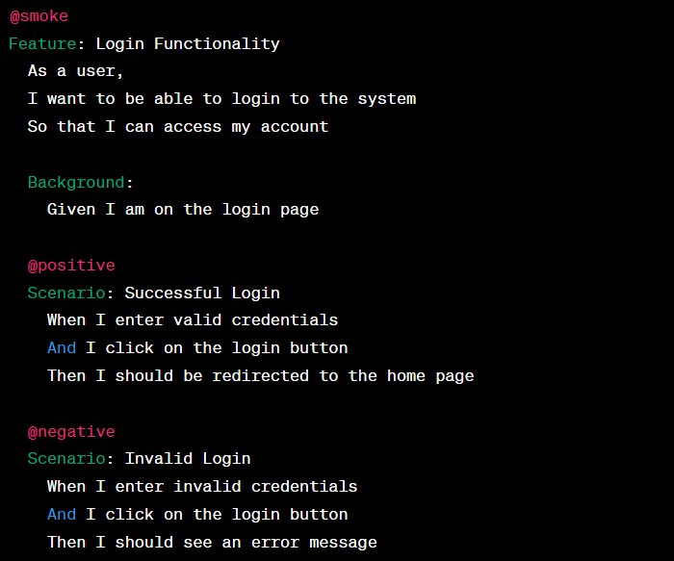
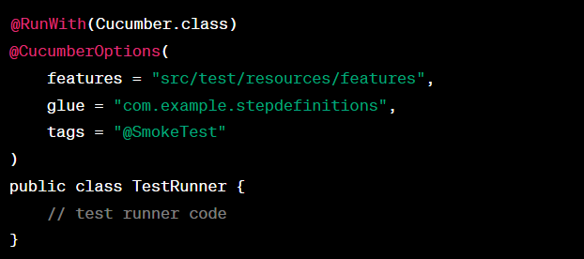
Cucumber Tags
Cucumber tags are used to label scenarios with one or more tags. Tags are simple strings that can be used to categorize scenarios in different ways. Tags can be used to group scenarios based on their functionality, their priority, or any other relevant criteria. Tags can also be used to exclude scenarios from a test run.
Here is an example of how to use tags in a feature file:
To execute the test cases based on tags we use
To ignore any tag we use “~@tag name”
We can run two tags simultaneously:
AND - {"@SmokeTesting , @SanityTesting"}
OR - {"@SmokeTesting" , "@SanityTesting"}
NOT - {"~@SanityTesting"}

Slide 8
Cucumber step definitions
Cucumber step definitions are the glue code that binds the feature files and the automation code together. They are used to define the actions that are executed when a particular step in a feature file is encountered during the execution of the Cucumber test.
Each step in a feature file is mapped to a step definition method using regular expressions. When Cucumber encounters a step, it searches for a matching step definition, and if found, executes the corresponding method.
Step definitions are written in Java or any other programming language supported by Cucumber. They typically have a method name, a regular expression that maps to the step in the feature file, and the code that implements the logic for the step.

Slide 9
Cucumber step definitions
Here is an example of a step definition:
@Given("^the user is on the login page$")
public void the_user_is_on_the_login_page() {
// Code to navigate to the login page
}
In this example, @Given is the annotation used to identify the step definition as a pre-condition step. The regular expression ^the user is on the login page$ maps to the corresponding step in the feature file. The method body contains the code to navigate to the login page.

Slide 10
Cucumber step definitions
Cucumber step definitions support the use of parameters to make the code more reusable. Parameters are defined in the regular expression using capture groups. The captured values are passed as arguments to the method.
Here is an example of a step definition with parameters:
@When("^the user enters username \"([^\"]*)\" and password \"([^\"]*)\"$")
public void the_user_enters_username_and_password(String username, String password) {
// Code to enter username and password
}
In this example, the regular expression ^the user enters username \"([^\"]*)\" and password \"([^\"]*)\"$ contains two capture groups that capture the username and password values. These values are passed as arguments to the method.
Cucumber step definitions can also be tagged using Cucumber tags. Tags are used to organize and filter the scenarios and steps in a feature file. They are defined using the @ symbol followed by a tag name.

Slide 11
Cucumber step definitions
Cucumber step definitions support the use of parameters to make the code more reusable. Parameters are defined in the regular expression using capture groups. The captured values are passed as arguments to the method.
Here is an example of a step definition with parameters:
@When("^the user enters username \"([^\"]*)\" and password \"([^\"]*)\"$")
public void the_user_enters_username_and_password(String username, String password) {
// Code to enter username and password
}
In this example, the regular expression ^the user enters username \"([^\"]*)\" and password \"([^\"]*)\"$ contains two capture groups that capture the username and password values. These values are passed as arguments to the method.
Cucumber step definitions can also be tagged using Cucumber tags. Tags are used to organize and filter the scenarios and steps in a feature file. They are defined using the @ symbol followed by a tag name.

Slide 12
Cucumber options
Cucumber options are used to configure and customize the behavior of Cucumber during test execution. They are typically specified in the test runner class to define various settings such as feature files, glue code, output formats, tags, and more. Here's an explanation of Cucumber options along with an example:
Features:
The features option is used to specify the location of feature files.
Example: @CucumberOptions(features = "src/test/resources/features")
Glue Code:
The glue option is used to specify the package or class where step definitions are located.
Example: @CucumberOptions(glue = "com.example.steps")
Tags:
The tags option allows you to selectively run scenarios or features based on tags assigned to them.
Example: @CucumberOptions(tags = "@smoke")
Plugins:
The plugin option is used to specify the output format and destination for the generated reports.
Example: @CucumberOptions(plugin = {"pretty", "html:target/cucumber-reports"})

Slide 13
Cucumber options
Dry Run:
The dryRun option is used to quickly check if all the step definitions have been implemented without executing the actual test scenarios.
Example: @CucumberOptions(dryRun = true)
Strict:
The strict option ensures that any undefined or pending steps result in a failure.
Example: @CucumberOptions(strict = true)
Formatting:
Cucumber provides various formatting options to control the output format and verbosity of the test execution results.
Example: @CucumberOptions(format = {"pretty", "json:target/cucumber-report.json"})

Slide 14
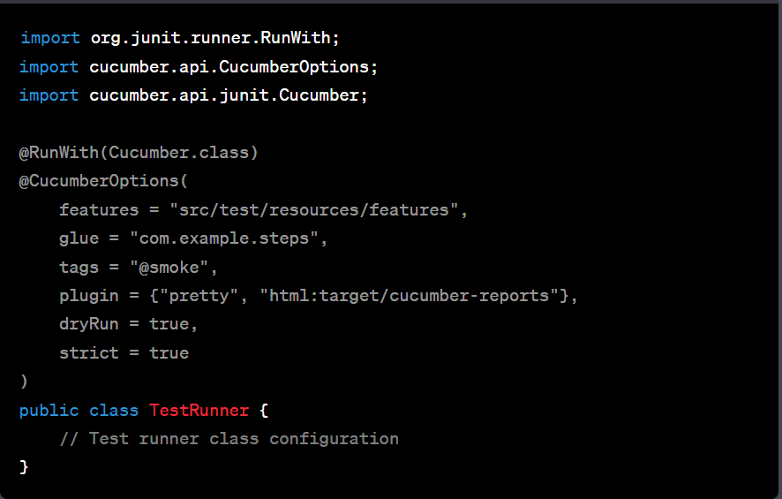
Cucumber options
Here's an example that showcases the usage of multiple options:

Slide 15
Cucumber options
In this example, the Cucumber options are specified using the @CucumberOptions annotation. The features are located in the "src/test/resources/features" directory, the step definitions are in the "com.example.steps" package, and only scenarios with the "@smoke" tag will be executed. The generated reports will be in HTML format and saved in the "target/cucumber-reports" directory. The test execution will perform a dry run without executing the actual steps, and any undefined or pending steps will result in failures.
Remember to customize the options according to your specific project structure and requirements.

Slide 16
Summary of topics covered
Cucumber Features are high-level descriptions of software behavior, written in Gherkin syntax in a feature file.
Anatomy of a Feature File includes Feature, Description, Scenario, Steps, and Tags.
Writing Feature Files involves defining the feature, writing scenarios with steps in Gherkin syntax, and adding tags to scenarios for organization and filtering.
Cucumber Tags are used to organize and filter scenarios in feature files. They can be used to mark scenarios as belonging to a certain category or requiring certain configurations to run.
Cucumber Step Definitions are Java methods that map Gherkin steps to automation code.
Anatomy of a Step Definition includes a pattern for the Gherkin step, the type of step (Given, When, Then), and the code to execute.
Writing Step Definitions involves defining the step pattern, type, and code to execute.
Cucumber options allow configuration of test execution behavior, including feature files, glue code, tags, plugins, and output formats. They provide flexibility and control over test execution and report generation. Utilize cucumber options to customize and streamline your Cucumber tests for efficient and meaningful results.

